Slide 2
<Session Title>
<Speakers>

Slide 3
Agenda
Subject A
Subject B
Subject C

Slide 4
Subject A

Slide 5
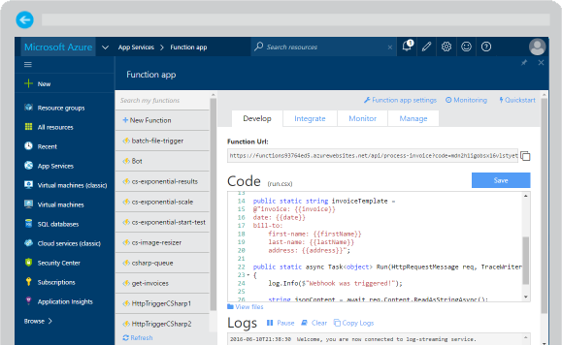
Azure Functions
Reusable nanoservices
Serverless
Event based
…

Slide 6
Subject B

Slide 7
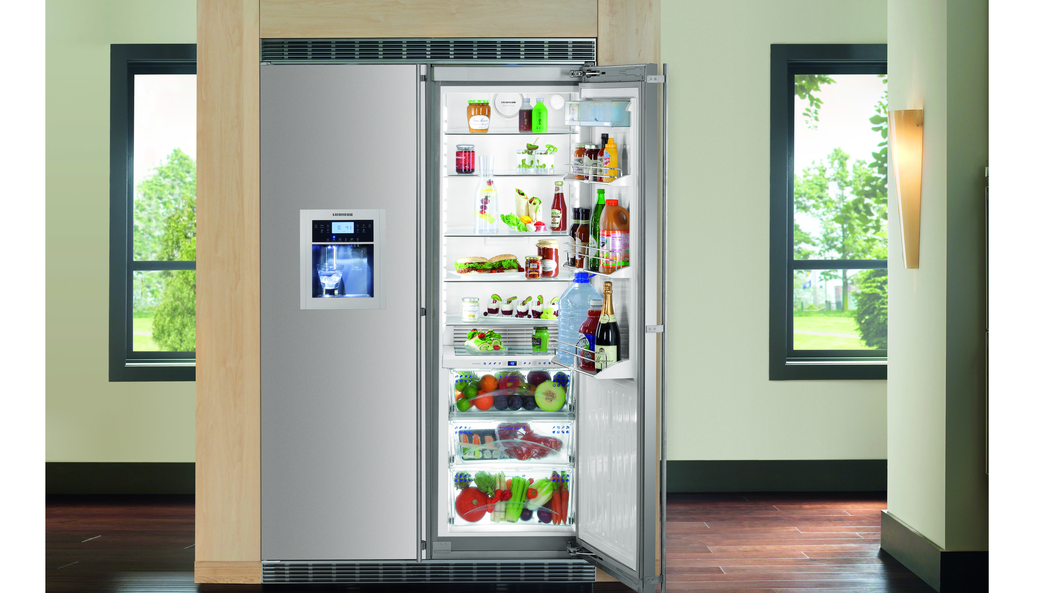
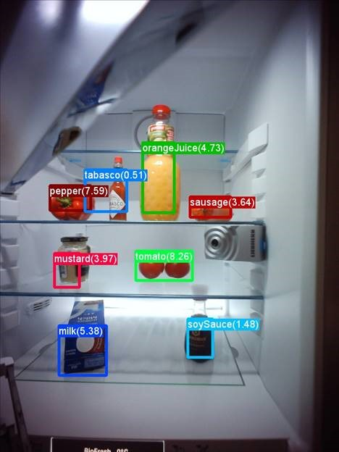

Smart Refrigerator

Slide 8
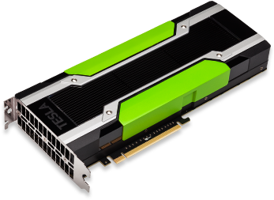
Azure NC-Instances
 | NC6 | NC12 | NC24 | NC24r
Cores | 6 | 12 | 24 | 24
GPU | 1 K80 GPU (1/2 Physical Card) | 2 K80 GPUs (1 Physical Card) | 4 K80 GPUs (2 Physical Cards) | 4 K80 GPUs (2 Physical Cards)
Memory | 56 GB | 112 GB | 224 GB | 224 GB
Disk | ~380 GB SSD | ~680 GB SSD | ~1.5 TB SSD | ~1.5 TB SSD
Network | Azure Network | Azure Network | Azure Network | InfiniBand

Slide 9
Call to Action
Azure Batch Shipyard @ https://github.com/Azure/batch-shipyard
Follow us @:
https://globalazuretorino.welol.it/
https://www.meetup.com/it-IT/meetup-microsoft-azure-torino/

